Slide 1
AI Study Group
Hands-on Machine Learning with Sci-kit-Learn, Keras & Tensorflow, Géron, 3rd Edition, Chapter 19 Discussion
May 29, 2024

Slide 2
Chapter 19: Training and Deploying Tensorflow Models
Tensorflow Serving
Vertex AI
GPU Considerations

Slide 3
A. Tensorflow Serving
A serving system is a software infrastructure designed to deploy, manage, and serve machine learning models in production environments. The primary purpose of a serving system is to make trained models available for use by applications and end-users, allowing them to generate predictions or inferences in real-time or batch model.
TensorFlow Serving (TS) is a flexible, high-performance serving system written in C++ and designed for machine learning models. Developed by Google, it also supports serving models trained with other machine learning frameworks.

Slide 4
A. Tensorflow Serving
TS supports versioned models, allowing seamless updates and rollbacks. You can deploy new versions of models without downtime.
TS provides both REST API and gRPC interfaces, making it easy to integrate with different client applications. A REST API is an API that uses standard HTTP verbs such as GET, POST, PUT and DELETE, and uses JSON as inputs and outputs. The gRPC protocol is more complex but more efficient – data is exchanged using protocol buffers.
TS is widely used for deploying machine learning models in production due to its robustness and ease of integration with the TensorFlow ecosystem.

Slide 5
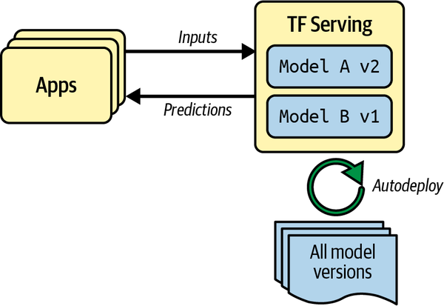
Tensorflow Serving (Figure 19-1)

Slide 6
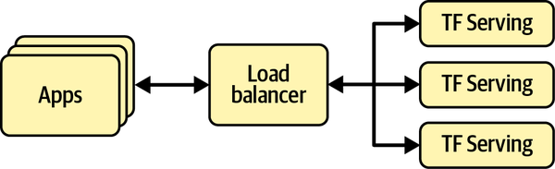
Scaling up TF Serving with Load Balancing (Figure 19-2)

Slide 7
B. Google Vertex AI
Google's Vertex AI is a managed machine learning platform designed to build, deploy, and scale machine learning models. It provides a unified environment that integrates Google's machine learning tools and services, simplifying the end-to-end process of developing and managing machine learning workflows.
Vertex AI simplifies the deployment and management of models, supporting versioning, monitoring, and scaling to ensure reliable and efficient operation in production environments.
By providing these comprehensive features, Vertex AI helps organizations streamline their machine learning workflows, from data preparation and model training to deployment and monitoring, enhancing productivity and accelerating time to value.

Slide 8
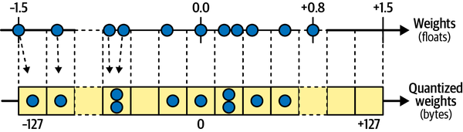
Quantization (Figure 19-5)

Slide 9
C. GPU
GPUs (Graphics Processing Units) can significantly speed up computation by leveraging their architecture, which is optimized for parallel processing. Unlike CPUs (Central Processing Units), which are designed for sequential serial processing and have a few cores optimized for single-threaded performance, GPUs consist of thousands of smaller, more efficient cores designed to handle multiple tasks simultaneously. This architecture makes GPUs exceptionally well-suited for computational tasks that can be parallelized.
Overall, GPUs enhance computational performance by distributing tasks across many cores, executing multiple operations simultaneously, and efficiently handling parallelizable workloads, which leads to significant reductions in computation time and increased processing power for complex and data-intensive tasks.

Slide 10
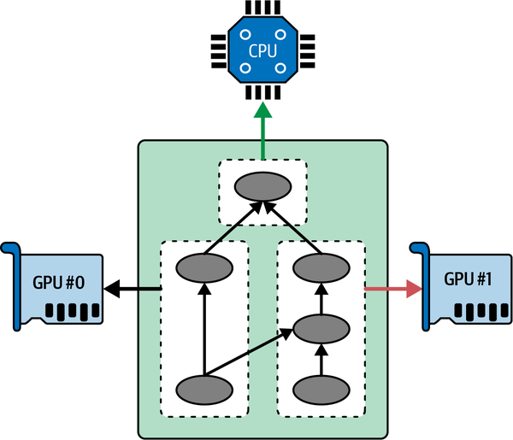
Executing a Tensorflow graph across multiple devices in parallel (Figure 19-6)

Slide 11
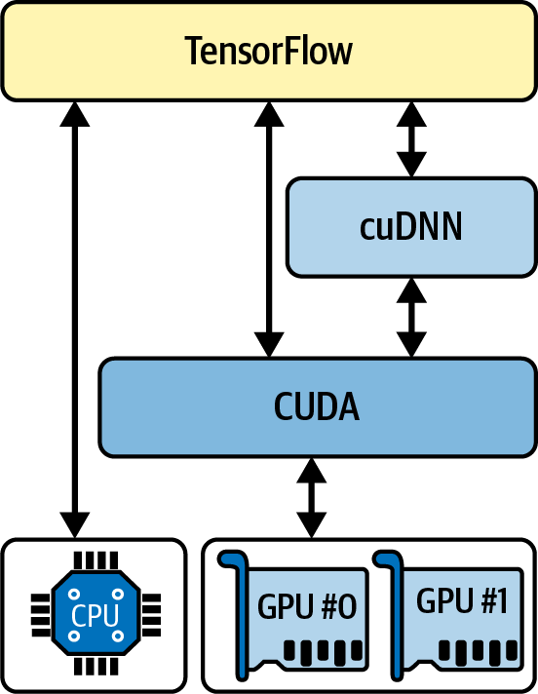
Tensorflow using CUDA and cuDNN to control GPUs. (Figure 19-7)

Slide 12
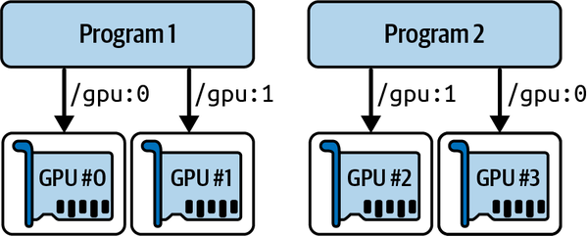
Each program gets two GPUs. (Figure 19-8)

Slide 13
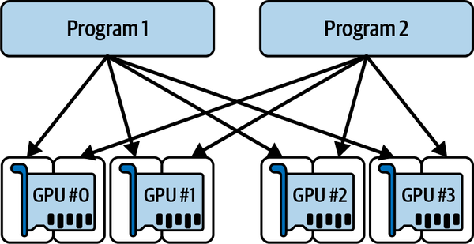
Each program gets all four GPUs, but only 2 GB of RAM on each GPU. (Figure 19-9)

Slide 14
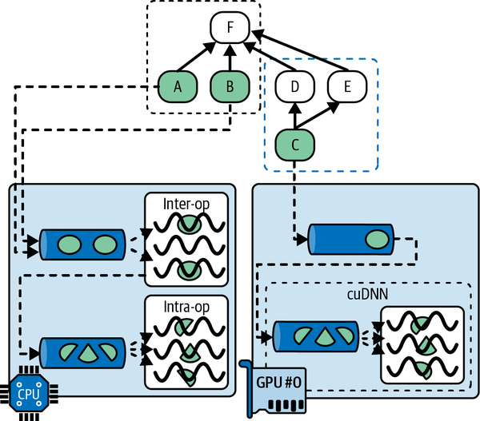
Parallel execution across multiple devices. (Figure 19-10)

Slide 15
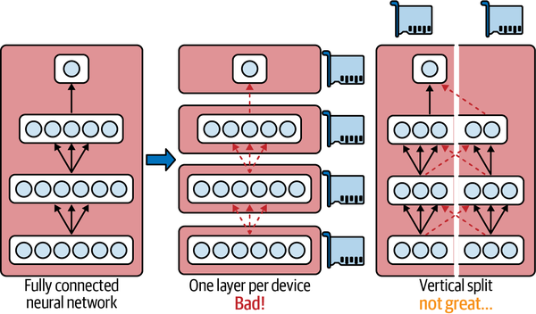
Splitting a fully connected neural network. (Figure 19-11)

Slide 16
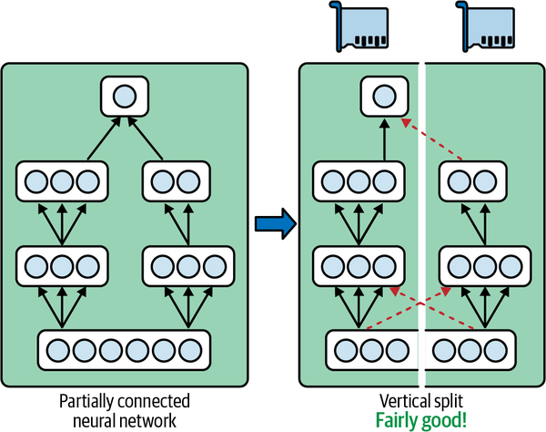
Splitting a partially connected neural network. (Figure 19-12)

Slide 17
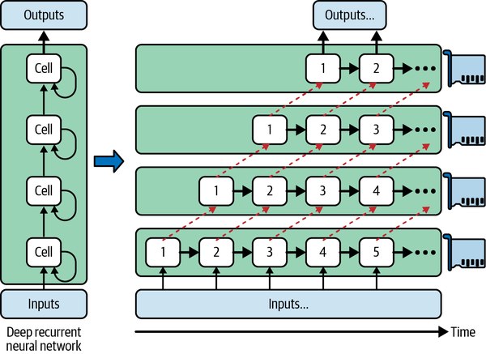
Splitting a deep recurrent neural network. (Figure 19-13)

Slide 18
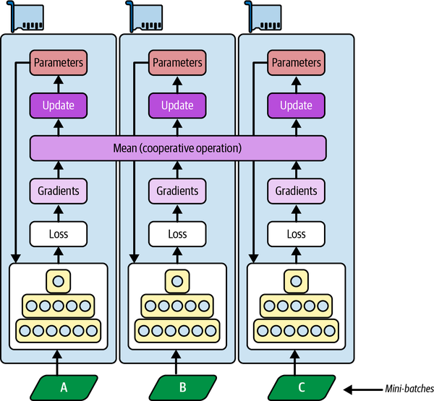
Data parallelism using a mirrored strategy. (Figure 19-14)

Slide 19
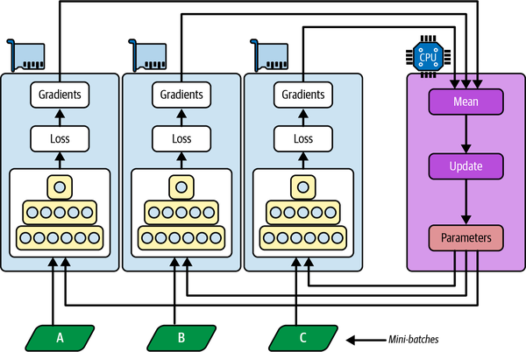
Data parallelism using centralized parameters. (Figure 19-15)

Slide 20

PipeDream’s pipeline parallelism. (Figure 19-17)

Slide 21
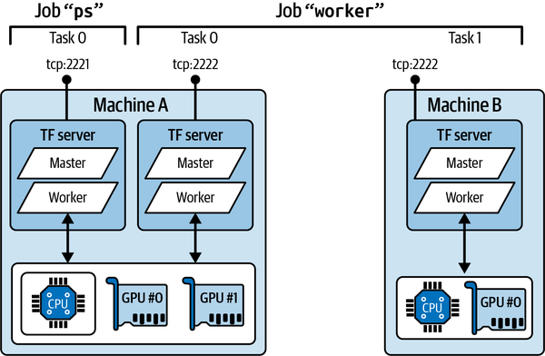
An example Tensorflow cluster. (Figure 19-18)

